Slide 1
Continuously Delivered & Scalable Geoservices on Kubernetes
Daniel Fenton
Esri R&D
@dmfenton

Slide 2
Quick Background
ArcGIS Hub:
Cities Publish Open Data
Work with Citizens to Solve Urban Problems
Product Launched in 2014
Actively Used by Hundreds of Organizations
Local Gov
State Gov
Federal Gov
NGOs
Private Business
E.g. https://data-stlcogis.opendata.arcgis.com/

Slide 3
Overview
Kubernetes @ 10k Feet
Spatial Download System Architecture
Jenkins and our CI/CD Pipeline
Key Component: Deployment
Kubeutils: FOSS Deployment CLI
Deployment Rollouts
Networking
Monitoring

Slide 4
Benefits
Faster time from idea to deployment
Faster and more complete feedback from production
Easier to debug
Easier to add new services
Automated, reliable deployments
Smooth Git Workflow
Scaling on autopilot
Fewer idle resources consumed

Slide 5
K8s @ 10k: Key Terminology
Cluster
Master & Nodes
Namespace
Pod
Deployment
Horizonal Pod Autoscaler
Service
Ingress

Slide 6
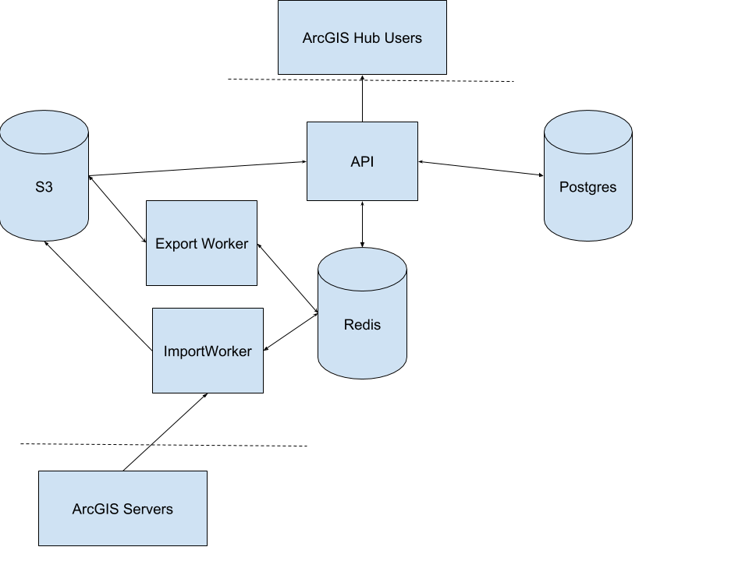
Download System Architecture
Feature Services => (ND) GeoJSON, KML, CSV, Shapefile, Geohash
15m per year, 1 TB per month
Spiky workloads
Delayed job system, refresh in background

Slide 7
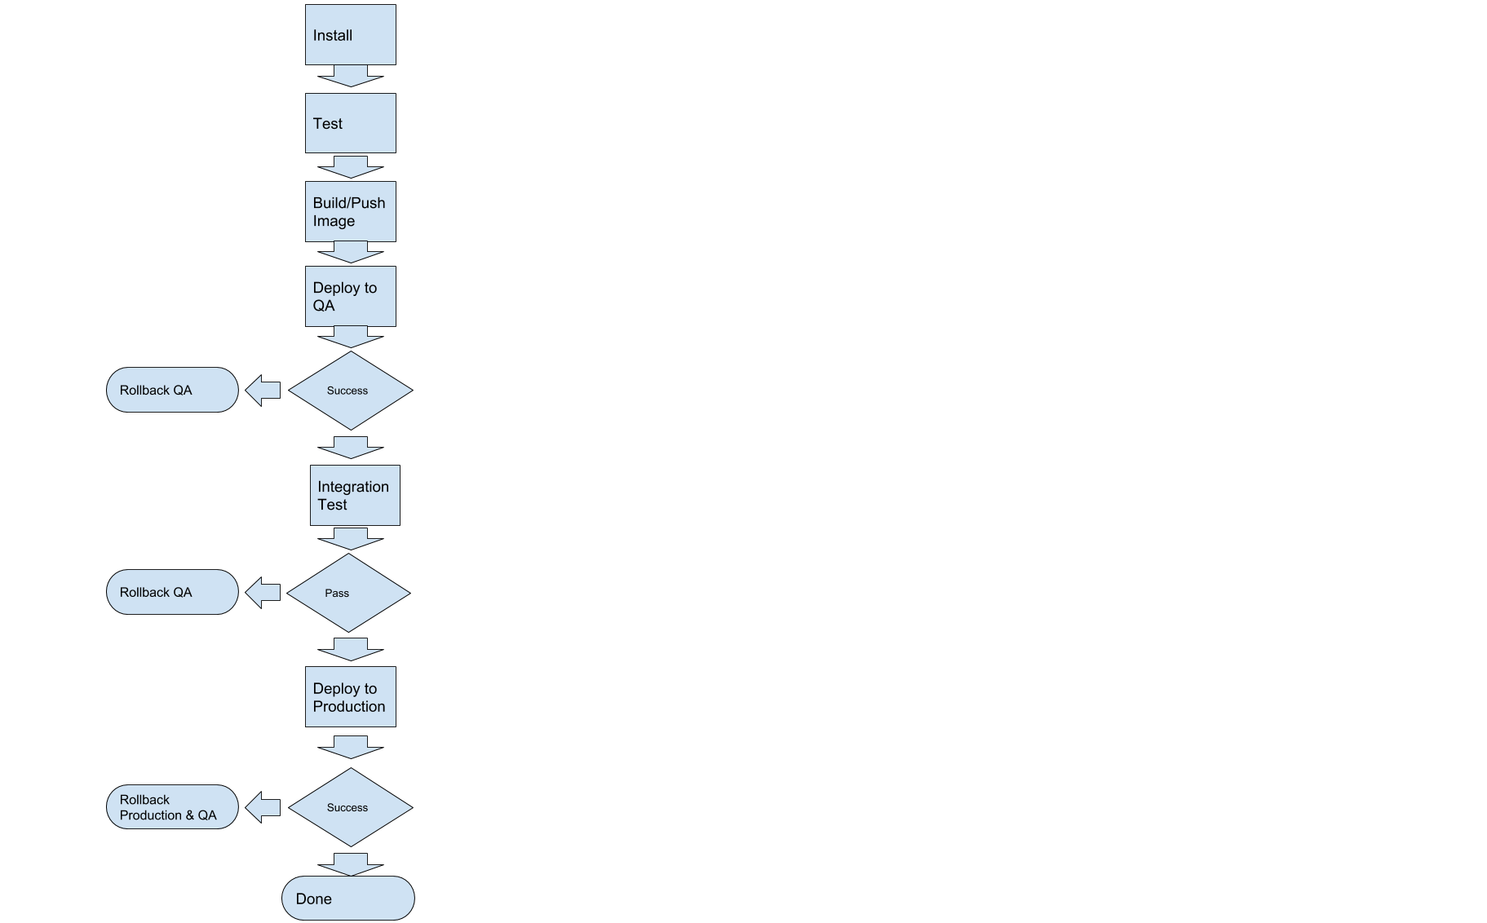
Jenkins Pipeline

Slide 8
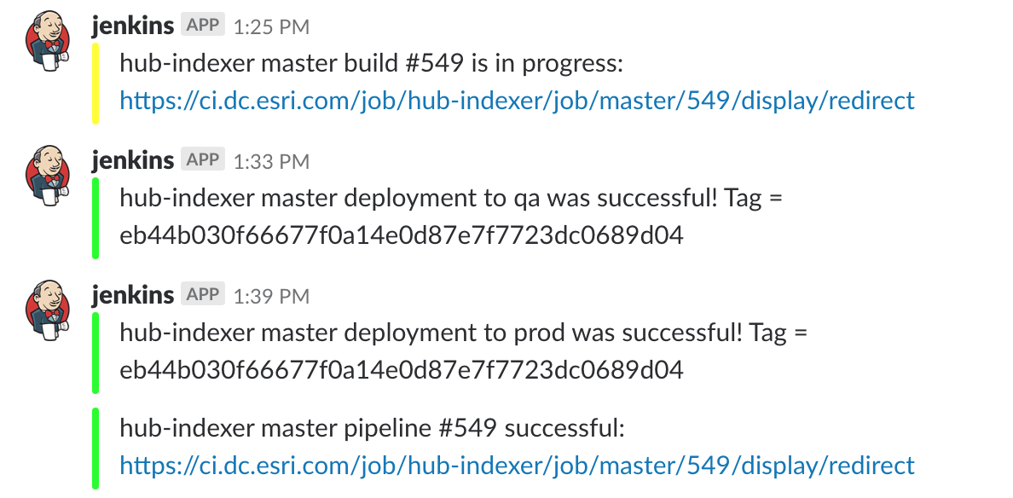

Slide 9
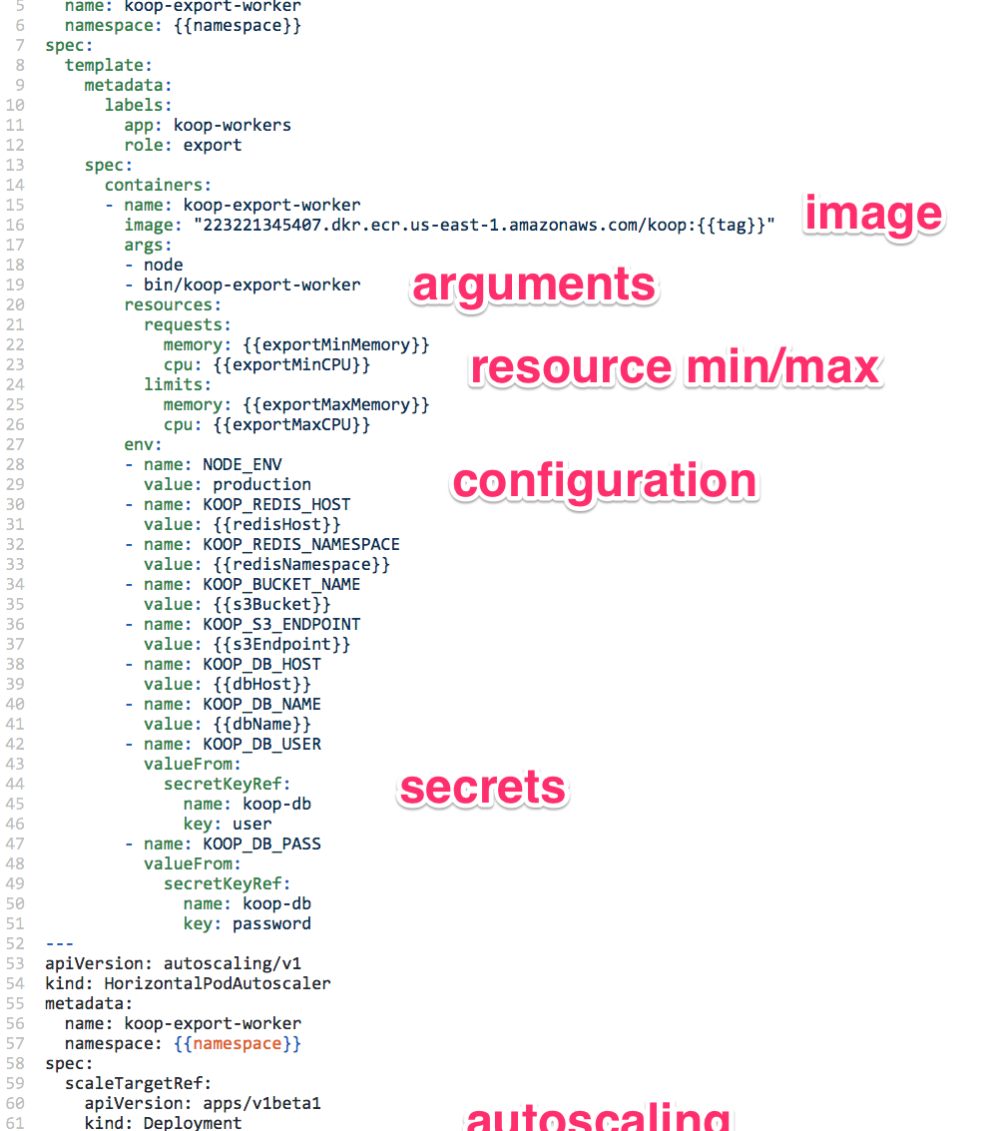
Deployment Configuration
Yaml for each service
API
Import Worker
Export Worker
Autoscaling Configuration in same file
Secrets referenced externally (safe to check in)
Changes to this file trigger a deploy

Slide 10
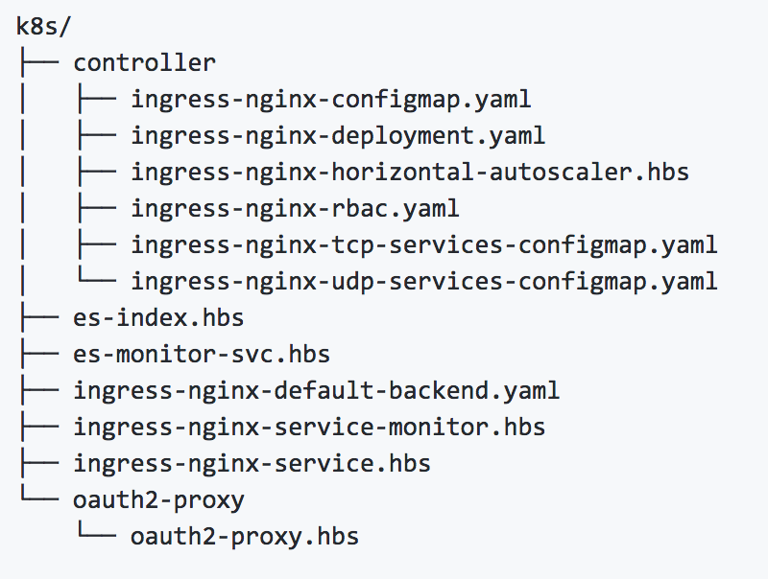
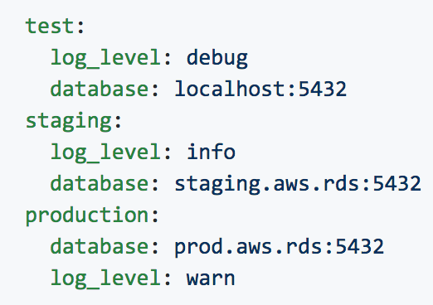
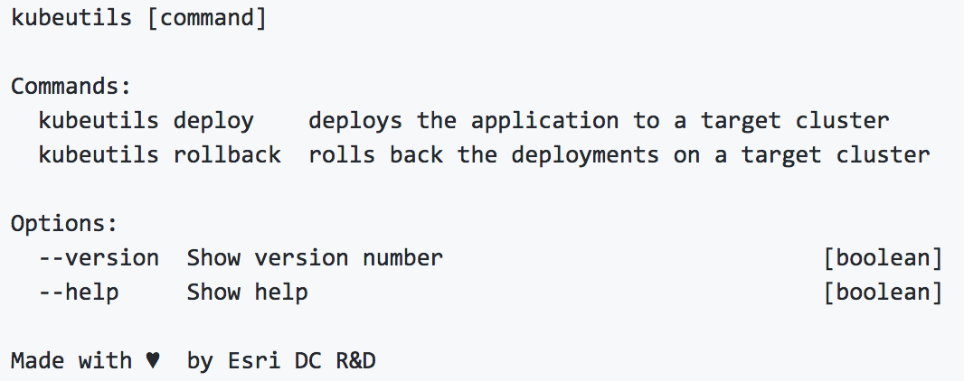
Kubeutils Deployment CLI

Slide 11
Rollouts: blue/green style
Each microservice implements “readiness check”
Is this service up and ready to handle traffic?
Scheduler adds new container with updated code
If readiness check passes => remove old container
Repeat until all old pods have been replaced with new pods
Updates sent in Slack Channel

Slide 12
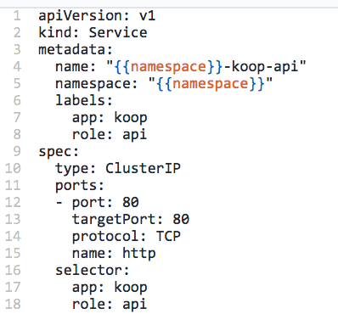
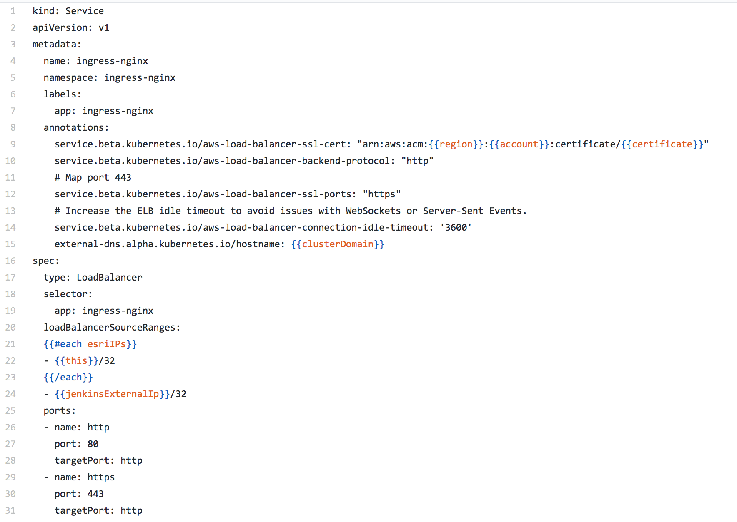
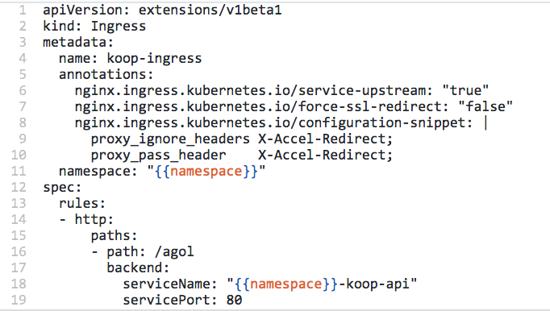
Networking

Slide 13
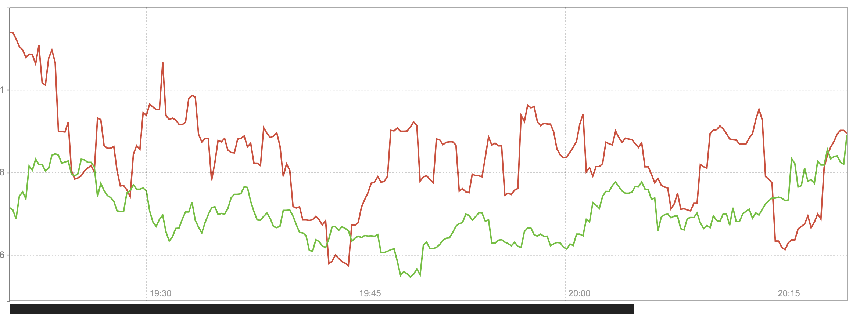
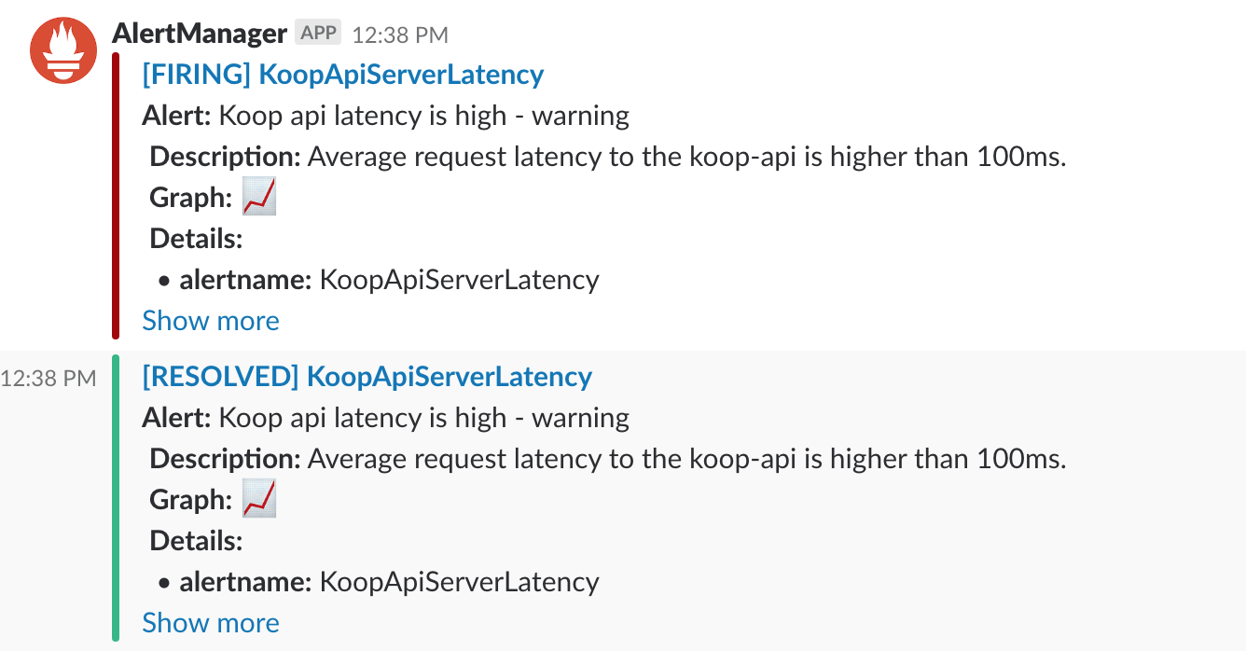
Monitoring
Logging Stack
FluentD Daemonset
3 Node Elasticsearch Statefulset
Kibana
Exposed on Internal Network
Behind Github Auth Proxy
Metrics/Alerting Stack
Run by Prometheus Operator
Prometheus Statefulset
Alertmanager Statefulset
Pagerduty + Slack Alerts

Slide 14
Links
Prometheus operator
Kubernetes Guide
ArcGIS Hub
Koop
Kubeutils
Kops
NGINX Ingress Controller
Cluster Autoscaler

